Slide 1
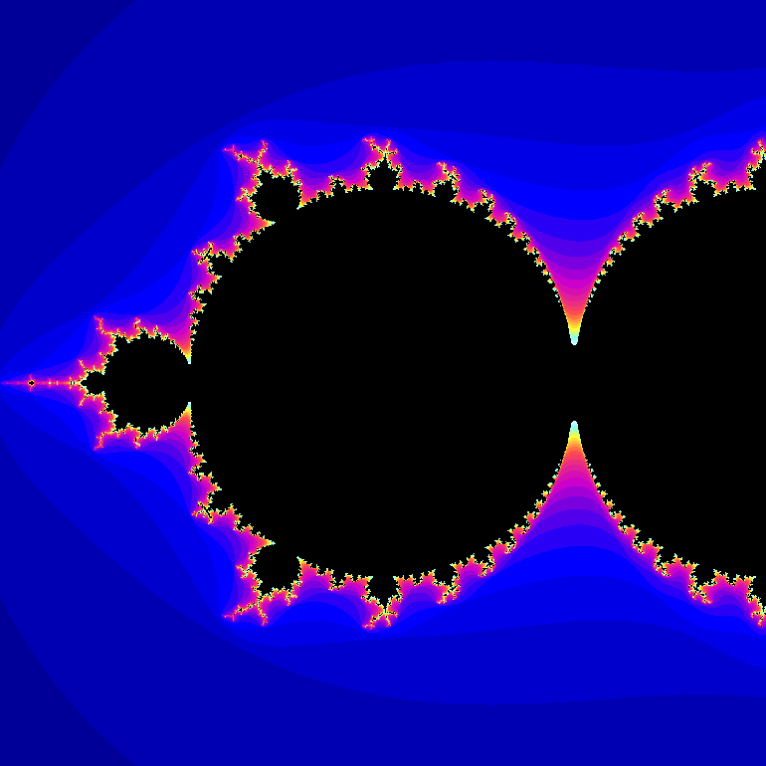
Emergent complexity
Chaos and fractals

Slide 2
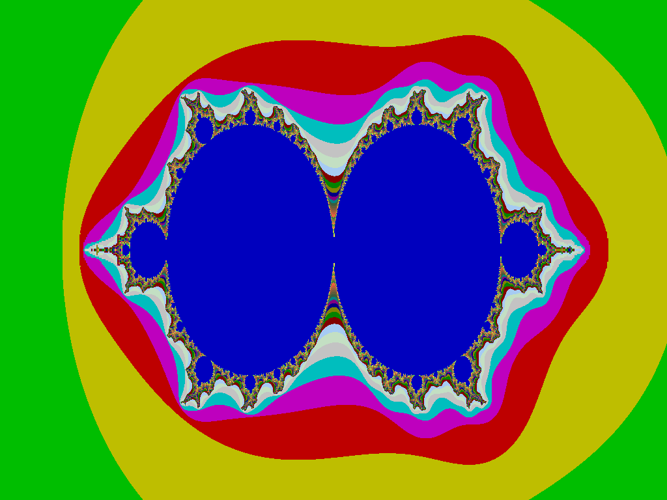
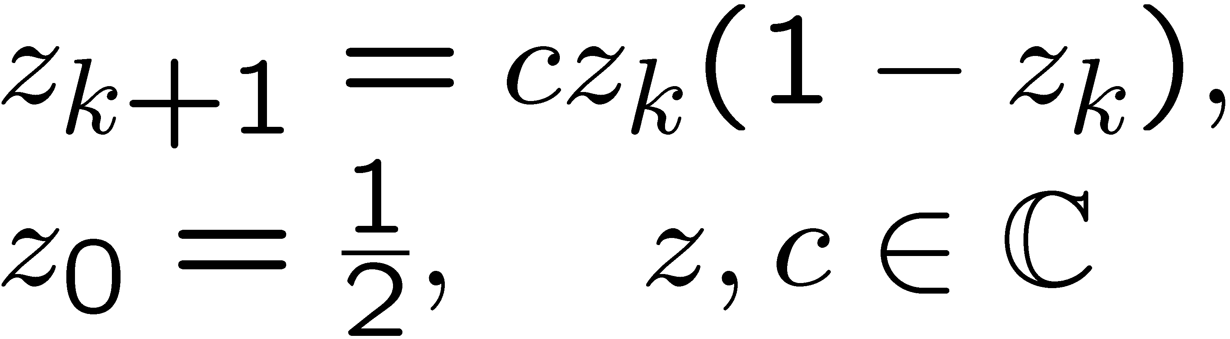
c-plane
Uncertain Dynamical Systems

Slide 3


Slide 4
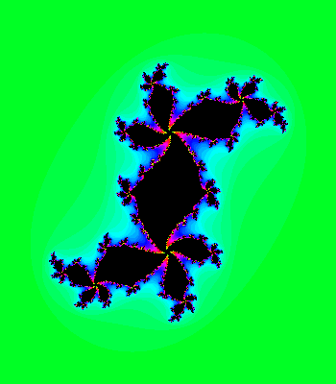

Slide 5
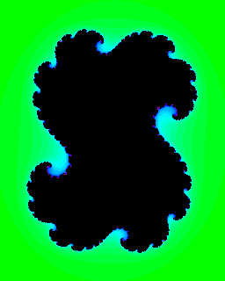
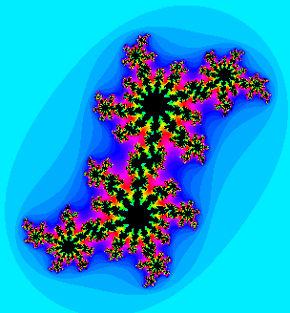
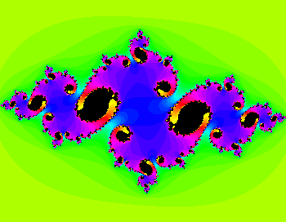
Julia sets

Slide 8
Overcoming computational complexity

Slide 9
What does this have to do with complex systems?
This classic computational problem illustrates an important idea, but in an easily visualized way.
Most computational problems involve uncertain dynamical systems, from protein folding to complex network analysis. Not easily visualized.
Natural questions are typically computationally intractable, and conventional methods provide little encouragement that this can be systematically overcome.

Slide 10
Main idea
e.g. the boundary moves.

Slide 11
Main idea
Points near the boundary are “fragile.”
Merely stating the obvious in this case.
But illustrates general principle that can be exploited by the right algorithms.

Slide 12

# iterations
5
10
Points not in M.
15
20
25
30

Slide 13
# iterations
5
10
Color indicates number of iterations of simulation to show point is not in M.
15
20
25
30

Slide 14
But simulation cannot show that points are in M.

Slide 15
But simulation is fundamentally limited
Gridding is not scalable
Finite simulation inconclusive

Slide 16
Main idea
It’s easy to prove that this disk is in M.
Other points in M are fragile to the definition of the map.
Merely stating the obvious.

Slide 17
Sufficient condition

Slide 19
Trivial to prove that these points are in Mandelbrot set.

Slide 20
Main idea
The proof of this region is a bit longer.
The longer the proof, the more fragile the remaining regions.

Slide 21
Main idea
Proof even longer.
And so on…

Slide 23
Easy to prove these points are in Mset.

Slide 24
Easy to prove these points are not in Mset.

Slide 25
Proofs get harder.
(But all still “easy.”)
What’s left gets more fragile.

Slide 26
Complexity
Chaos
≈ Fractals
Emergent complexity.

Slide 27
Complexity
implies fragility
What matters to organized complexity.

Slide 28
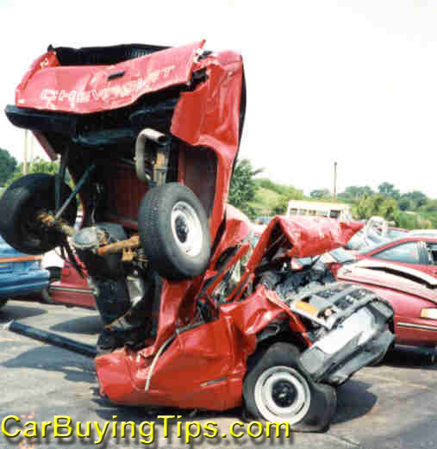
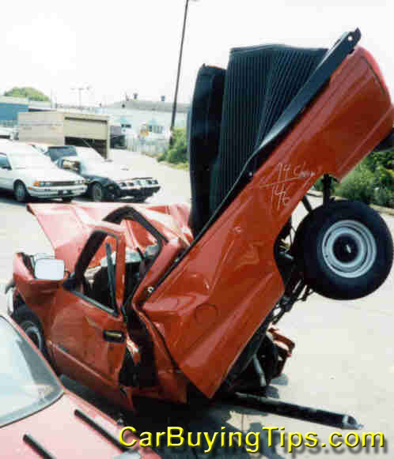
Emergent complexity

Slide 29
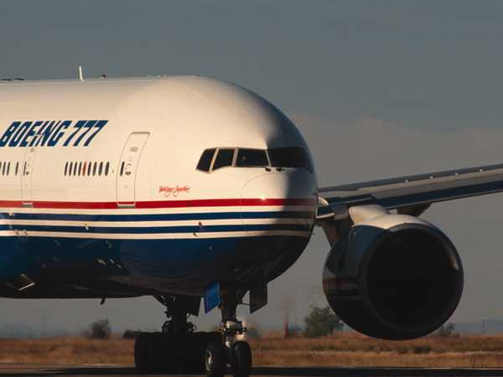
How might this help with organized complexity and “robust yet fragile”?
Long proofs indicate a fragility.
Either a true fragility (a useful answer) or an artifact of the model (which must then be rectified)
Potentially fundamentally changes computational complexity for organized complexity
Brings back together two research areas that have been separated for decades:
  Numerical analysis and ill-conditioning
  Computational complexity (P, NP/coNP, undecidable)

Slide 30
Proof?
New proof methods that is scalable and systematic (can be automated).

Slide 31
Breaking hard problems
SOSTOOLS proof theory and software
Nested family of (dual) proof algorithms
Each family is polynomial time
Recovers most “gold standard” algorithms as special cases, and immediately improves
No a priori polynomial bound on depth (otherwise P=NP=coNP)
Conjecture: Complexity implies fragility

Slide 32
Safety Verification and Reachability Analysis
Safety critical applications.
Exhaustive simulation is not exact.
Set propagation is computationally expensive.
B(x) = 0
Find a barrier certificate B(x)
Unsafe set
Initial set
Scalable computation using SOS machinery.

Slide 33
Hybrid, Uncertain, Stochastic
Hybrid systems can be handled easily,
even for systems with uncertainty:
Parametric
Memoryless
Dynamic (IQC)
(Prajna, Jadbabaie – HSCC ’04)
Also stochastic hybrid systems:
Use supermartingales as certificates.
Get guaranteed bound on reach
probability.
(Prajna, Jadbabaie, Pappas – CDC ’04)

Slide 34
Functional
requirements
Unifying role of dual proofs and decomp-ositions
Variable supply/demand
Feedback
control
“Vertical”
layering
“Horizontal”
Decompositions
Physical network
Components
Hardware
constraints

Slide 35
Main idea
Think of this as a robustness problem.

Slide 36
Globally stable.
How robust is stability to perturbations in c?

Slide 37
Region of convergence.
How robust is stability to perturbations in c?

Slide 39
Simulation is fundamentally limited

Slide 40
Simulation is fundamentally limited

Slide 41
# iterations
5
10
15
20
25
30

Slide 42
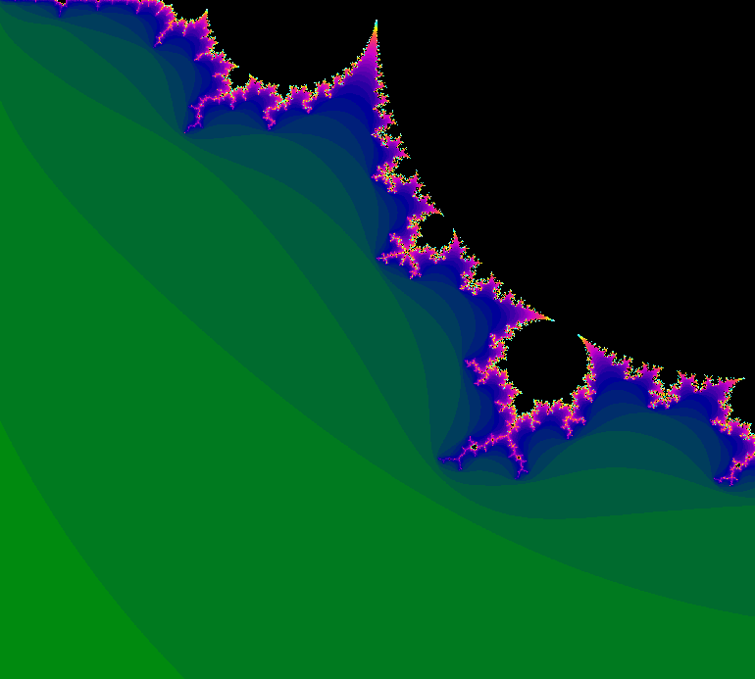

iterations
10
20
30
40
50
60

Slide 43
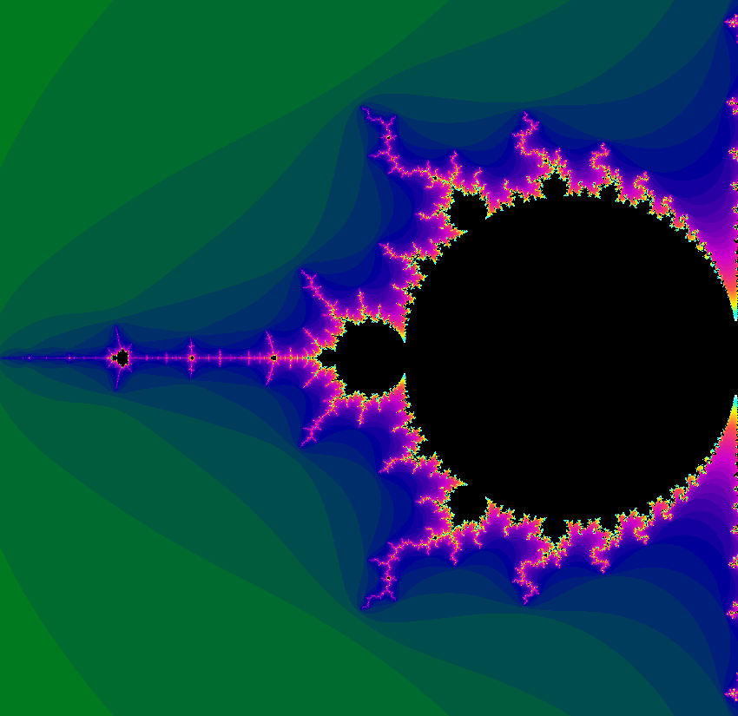
iterations
10
20
-2
30
40
50
60

Slide 44
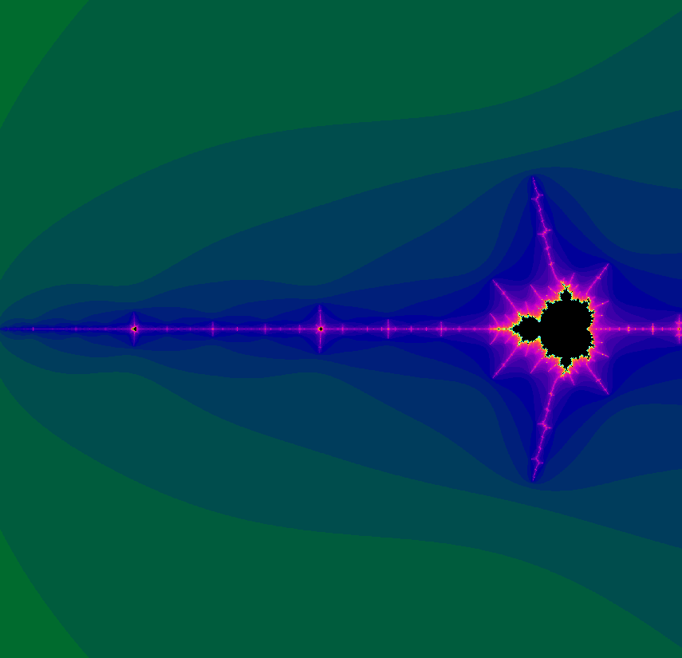
iterations
10
20
-2
30
40
50
60

Slide 45
iterations
10
20
30
40
50
60

Slide 46
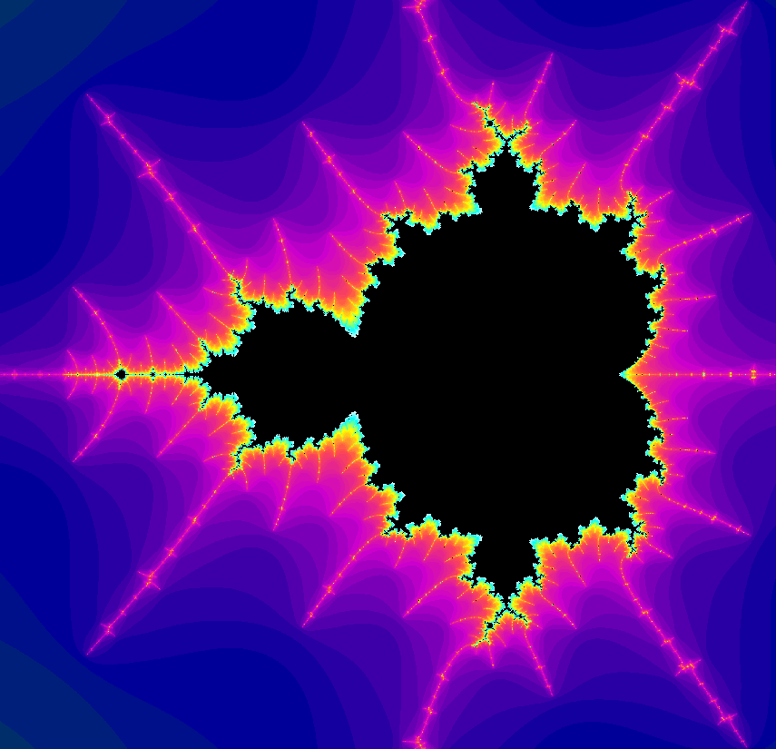
iterations
10
20
30
40
50
60

Slide 47
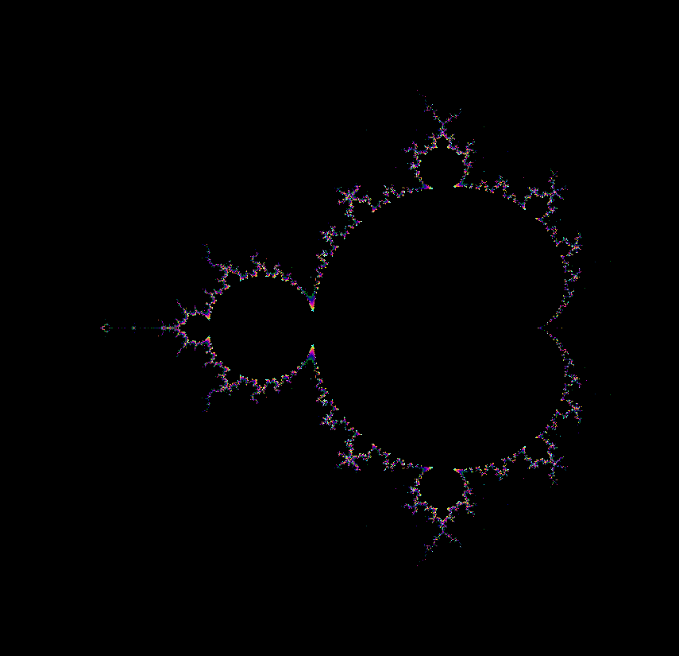
iterations
70
120

Slide 48
iterations
60
120

Slide 52
c
real

Slide 53
Fixed points
4
3
Stable
2
1
0
Stable
-1
Unstable
-2
-3
-2
-1
0
1
2
3

Slide 54
Fixed points
4
3
Stable
2
Unstable
1
0
Stable
-1
-2
-3
-2
-1
0
1
2
3

Slide 55
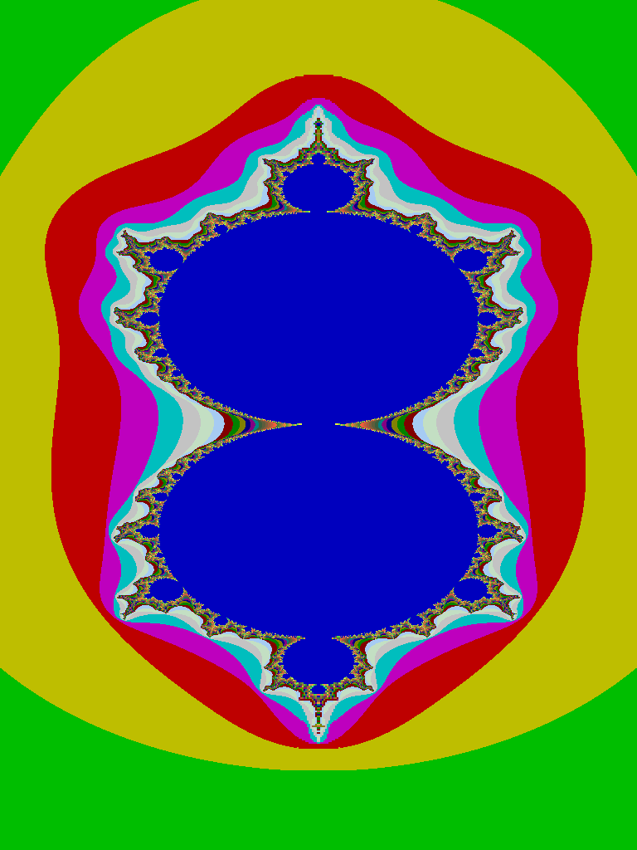
Equilibria
4
3
2
1
0
Stable
-1
Unstable
-2
-3
-2
-1
0
1
2
3

Slide 56
4
3
2
1
0
-1
-2
-3
-2
-1
0
1
2
3

Slide 57
Sufficient condition

Slide 59
Trivial to prove that these points are in Mandelbrot set.

Slide 60
Equilibria
4
3
2
1
0
-1
Unstable
-2
-3
-2
-1
0
1
2
3

Slide 62
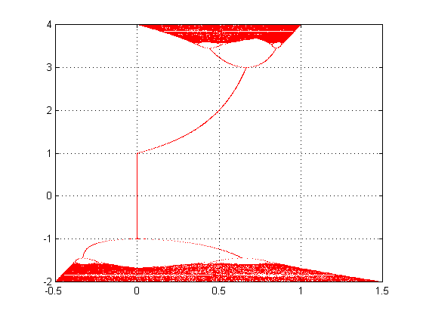
Bifurcations for
c
“last 200 x”

Slide 63
Zoom-in
c
“last 200 x”

Slide 64
Zoom-in
c
“last 200 x”

Slide 65
stable
0
-1
Bifurcations to chaos
-2
-3
-2
-1
0
1
2
3

Slide 66
1
0
0
-1
-1
-2
-2
-3
-2
-1
0
1
2
3

Slide 67
1
0
0
-1
-1
-2
-2
-3
-2
-1
0
1
2
3

Slide 68
4
3
2
1
0
-1
-2
-3
-2
-1
0
1
2
3

Slide 69
4
3
2
1
0
-1
-2
-3
-2
-1
0
1
2
3

Slide 70
stable
0
-1
Bifurcations to chaos
-2
-3
-2
-1
0
1
2
3

Slide 71
Invariant set?
Invariance

Slide 72
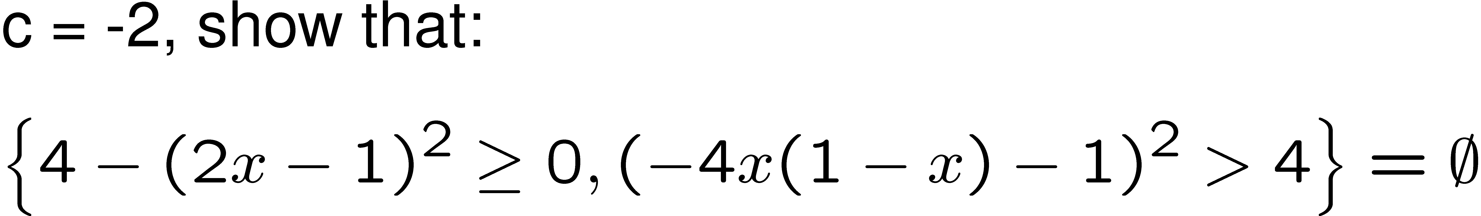
0
-1
Bifurcations to chaos
-2
-3
-2
-1
0
1
2
3

Slide 73
Special case of SOS

Slide 74
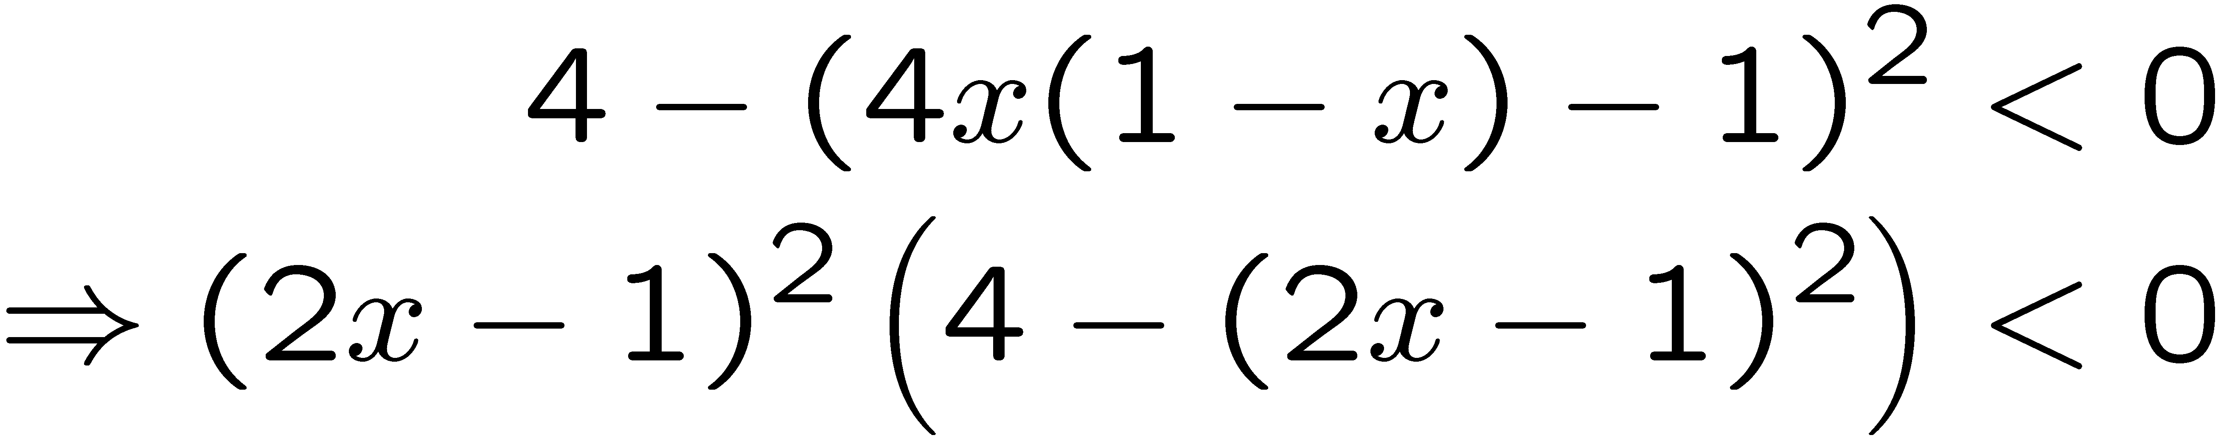
Special case of SOS

Slide 75
Contradiction!
Special case of SOS
Special case of SOS

Slide 76
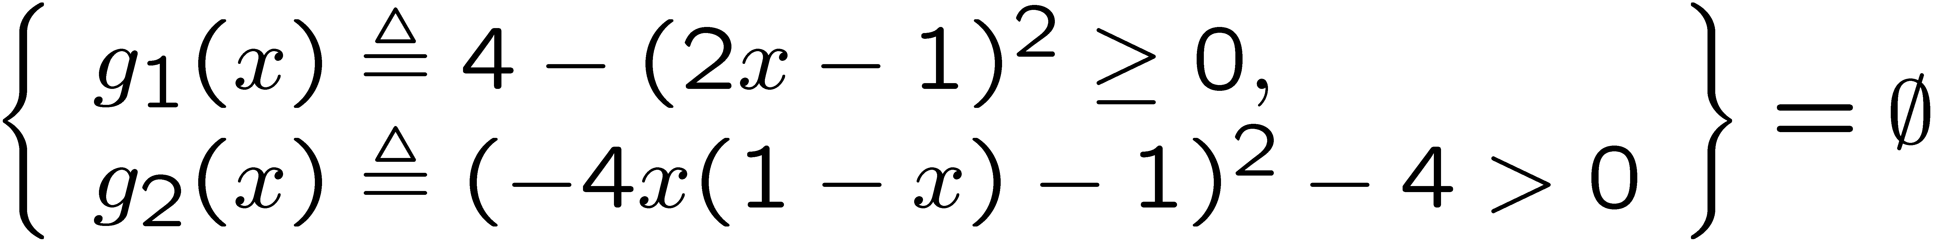
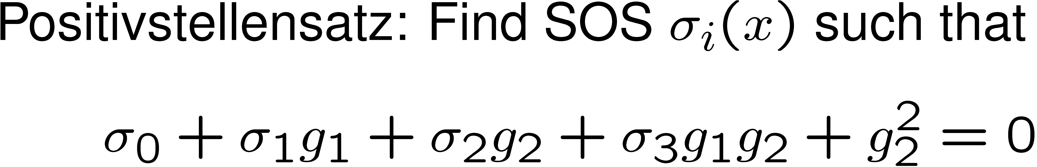
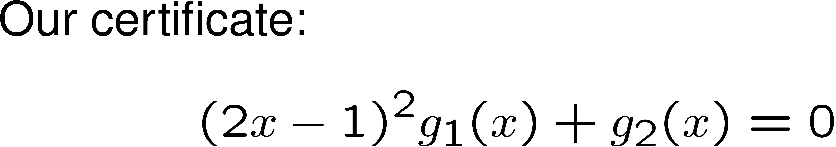

Slide 77
0
-1
-2
-3
-2
-1
0
1
2
3
Can prove the whole yellow region using SOSTOOLS!
What is the shortest proof possible?

Slide 78
Lyapunov argument

Slide 79
How to prove membership?
2-period lobes

Slide 80
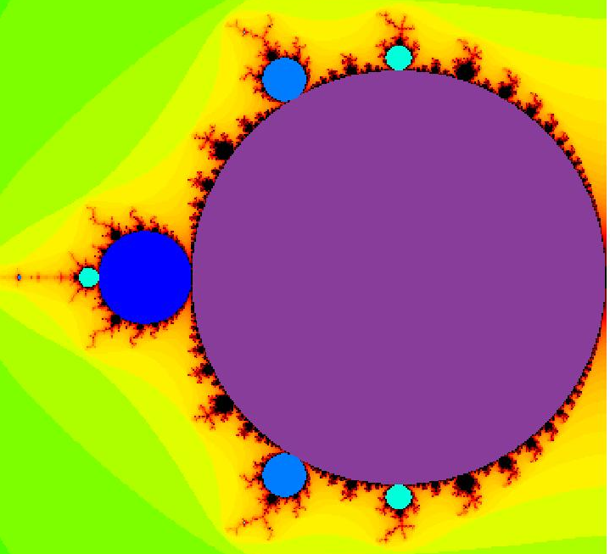
4
3
Proof lengths
2
1
4
3
4

Slide 81
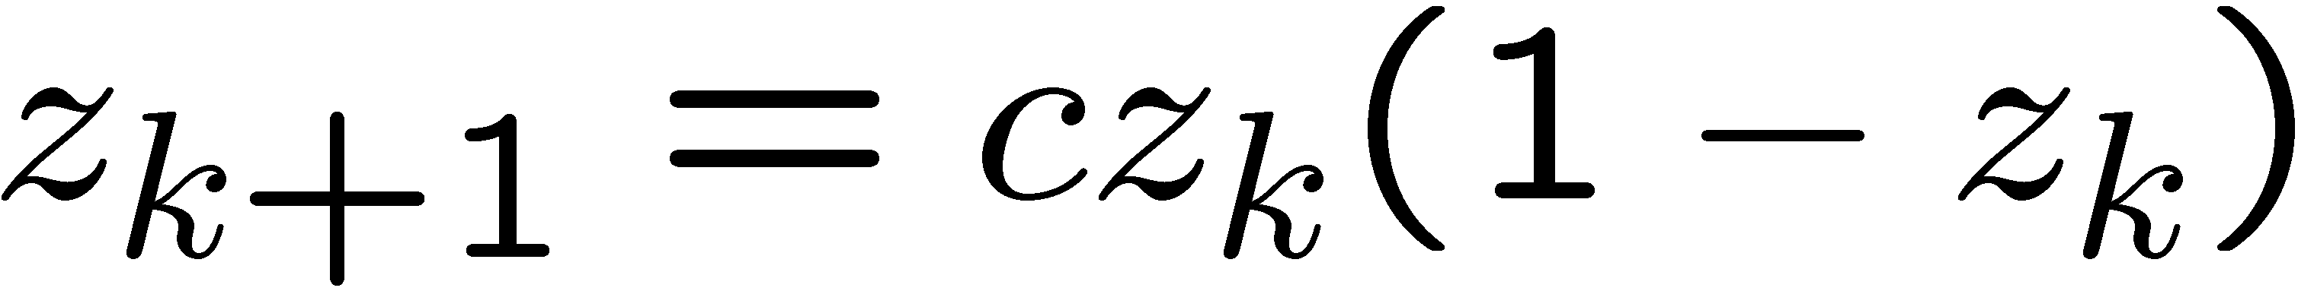
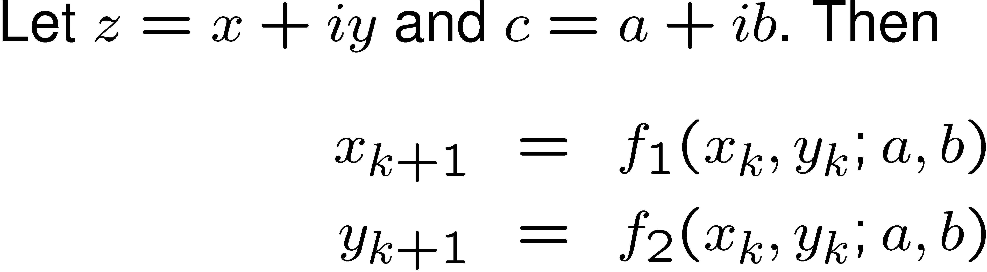
Prove membership of 2-period lobe:
Using a stability argument of the 2-period map.
Using an invariance argument.

Slide 82
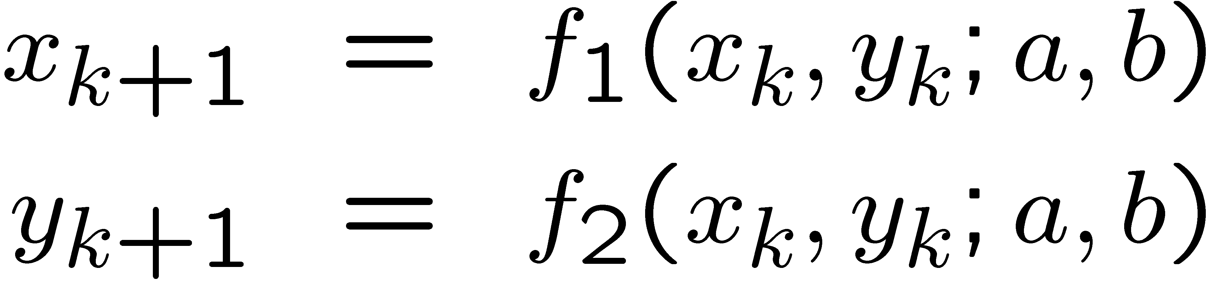
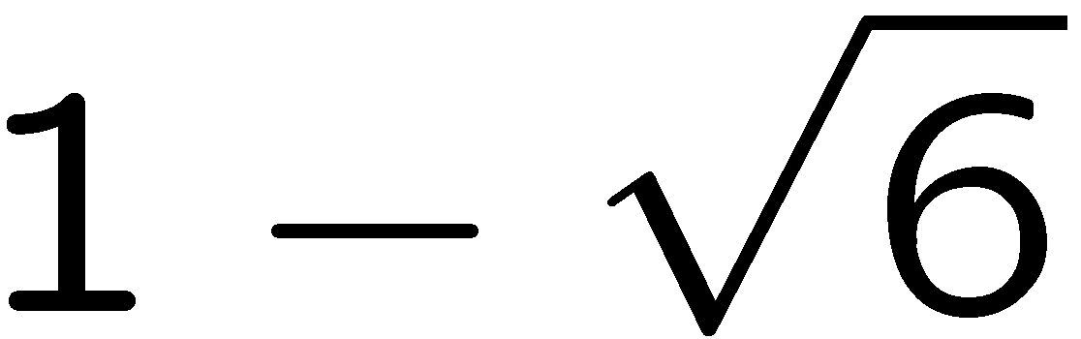
Formulate the invariance
Problem as the emptiness
of a semialgebraic set.
Then use SOSTOOLS
to construct the
certificate.
-1

Slide 83
Discrete → Continuous

Slide 84
Lyapunov’s theorem

Slide 86
Can we test these conditions
algorithmically?
Use the Sum of Squares decomposition!

Slide 87
SOSTOOLS
Find
such that
is SOS
is SOS
Then equilibrium is asymptotically stable.

Slide 88
Robust Stability?
Use SOSTOOLS to construct V(x,p).
www.cds.caltech.edu/sostools

Slide 89
Chemical oscillator
Nondimensional state equations

Slide 90
1
Can be computed analytically, which is not scalable.
0.8
a
0.6
0.4
0.2
0
0
0.2
0.4
0.6
0.8
1
1.2
1.4
b

Slide 91
3
2.5
2
1.5
1
a = 0.1, b = 0.13
0.8
1
a
0.6
0
0.1
0.2
0.3
0.4
0.5
0.6
0.4
Numerical simulation.
0.2
0
0
0.2
0.4
0.6
0.8
1
1.2
1.4
b

Slide 92
1
1
a = 0.6, b = 1.1
a = 1, b = 2
0.8
0.8
y
0.6
0.6
0.4
0.4
0.2
0.2
0
0
1
1.5
x
2
2.5
2.2
2.6
3
3.4
1
0.8
(1.1, 0.6)
(2, 1)
a
0.6
0.4
0.2
0
0
0.2
0.4
0.6
0.8
1
1.2
1.4
b

Slide 93
1
0.8
a
0.6
0.4
0.2
0
0
0.2
0.4
0.6
0.8
1
1.2
1.4
b

Slide 94
equilibrium

Slide 95
1
0.8
a
0.6
0.4
0.2
0
0
0.2
0.4
0.6
0.8
1
1.2
1.4
b

Slide 96
Set of bad system behaviors
Set of possible system behaviors
Proof of robustness
Modeling
Analysis
More on Saturday

