Slide 1
Mechanics+
Gravity +
Light +
vision
Balancing an inverted pendulum
delay
+ Neuroscience
Act

Slide 2
vision
delay
Balancing an inverted pendulum
Act

Slide 3
Law #1 : Mechanics
(instead of chemistry)
Law #2 : Gravity
(instead of autocatalysis)
easy
hard
linearize

Slide 4
m
linearize
M

Slide 5
Law #3 : Light
Why?
vision
delay
hard
harder
Act
Easy to prove using simple models.

Slide 6
noise
error
eye
vision
slow
delay
Control
Act

Slide 7
Law #4 :
8
Fragility
4
2
1
.05
.1
.2
.5
1
Length l (meters)

Slide 8
Law #4 :
8
Fragility
4
2
1
.05
.1
.2
.5
1
Length l (meters)

Slide 9
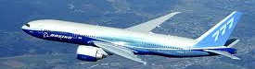
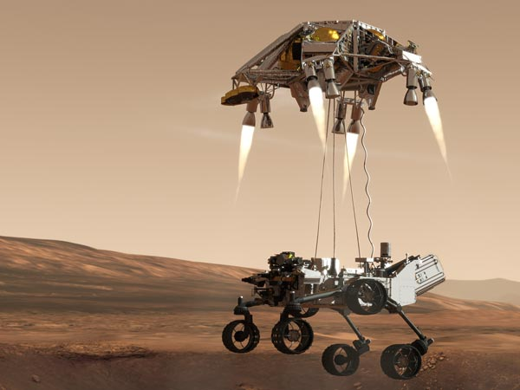
Crashes can be made rare with active control.

Slide 10
What is sensed matters.
hard
harder
hardest!
Why?
Easy to prove using simple models.

Slide 11
What is sensed matters.
hard
harder
hardest!
Unstable poles
Unstable zeros

Slide 12
8
Fragility
4
2
1
.05
.1
.2
.5
1
Length (meters)

Slide 13
1.2
easy
3.5
1
3
fragile
(hard)
Measure
Length
l₀, m
0.8
2.5
0.6
hard
2
hard
0.4
1.5
robust
(easy)
1
0.2
0.4
0.6
0.8
1
Length l to CoM, m

Slide 14
Mechanics+
Gravity +
Light +
Completing the story
vision
Balancing an inverted pendulum
delay
+ Neuroscience
Act

Slide 15
Explain this amazing system.
Slow
Vision
Fast
Flexible
Inflexible

Slide 16
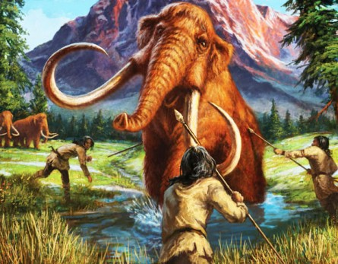
Neuroscience motivation
Robust vision with motion
Motion
Vision

Slide 17

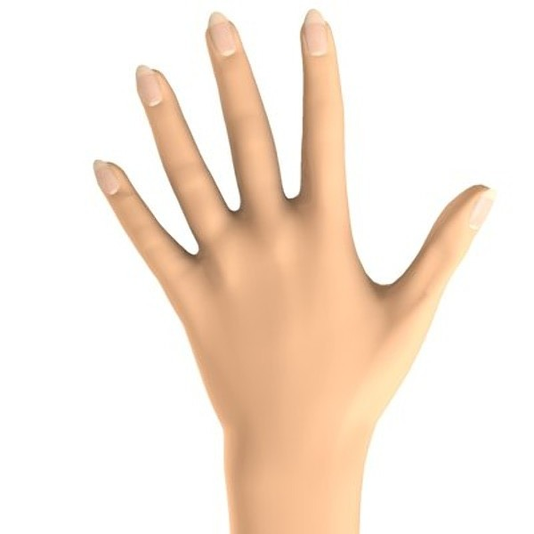
Experiment
Motion/vision control without blurring
Which is easier?

Slide 18
Why?
Mechanism
Tradeoff
Slow
vision
VOR
Fast

Slide 19
Mechanism
Vestibular Ocular Reflex (VOR)
Slow
vision
Tradeoff
VOR
Fast
Flexible
Inflexible

Slide 20
eye
vision
slow
Act
delay
Slow
vision
Fast
Flexible
Inflexible

Slide 21
eye
vision
fast
slow
Act
delay
Slow
vision
VOR
Fast
Flexible
Inflexible

Slide 22
eye
fast
Act
Vestibular Ocular Reflex (VOR)
Slow
VOR
Fast
Flexible
Inflexible

Slide 23
eye
fast
Act
Slow
VOR
Fast
Flexible
Inflexible

Slide 24
eye
vision
fast
slow
Act
delay
Slow
vision
VOR
Fast
Flexible
Inflexible

Slide 25
eye
vision
slow
Act
Highly
evolved
(hidden)
architecture
delay
Slow
vision
Illusion
Fast
VOR
Flexible
Inflexible

Slide 26
eye
vision
fast
slow
Act
delay
Slow
vision
Illusion
Fast
VOR
Flexible
Inflexible

Slide 27
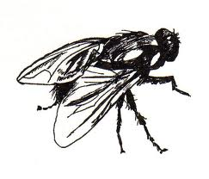
Fragile
Slow
Ideal
Fast
Flexible
Inflexible

Slide 28
Fragile
Slow
Architecture (constraints that deconstrain)
Architecture
Impossible (law)
Ideal
Fast
Flexible
Inflexible

Slide 29
eye
vision
fast
slow
Act
delay
Slow
vision
VOR
Fast
Flexible
Inflexible

Slide 30
VOR
eye
vision
slow
delay
Act
fast
Balancing an inverted pendulum
Control
Act

Slide 31
noise
error
eye
vision
slow
delay
Control
Act

Slide 32
Law #4 :
8
Fragility
4
2
1
.05
.1
.2
.5
1
Length l (meters)

Slide 33
What is sensed matters.
hard
harder
hardest!
Why?
Easy to prove using simple models.

Slide 34
8
Fragility
4
2
1
.05
.1
.2
.5
1
Length (meters)

Slide 35
1.2
easy
3.5
1
3
fragile
(hard)
Measure
Length
l₀, m
0.8
2.5
0.6
hard
2
hard
0.4
1.5
robust
(easy)
1
0.2
0.4
0.6
0.8
1
Length l to CoM, m

Slide 36
Slowest
3D +
motion
color
vision
eye
vision
fast
slow
Act
delay
Slow
vision
VOR
Fast
Flexible
Inflexible

Slide 37
B&W (luminence only):
3D, motion, and action
3D +
motion
eye
vision
fast
slow
Act
delay
Slow
vision
VOR
Fast
Flexible
Inflexible

Slide 38
Stare at the intersection
This is pretty good.

Slide 40
Stare at the intersection
This is pretty good.

Slide 42
Slowest
3D +
motion
color
vision
eye
vision
fast
slow
Act
delay
Slow
vision
VOR
Fast
Flexible
Inflexible

Slide 43
Seeing is dreaming
color
vision
Slow
vision
VOR
Fast
Flexible
Inflexible

Slide 44
slower
Objects
Slow
3d+motion
B&W
-
Mixed
slow
fast
VOR
Fast
Flexible
Inflexible

Slide 45
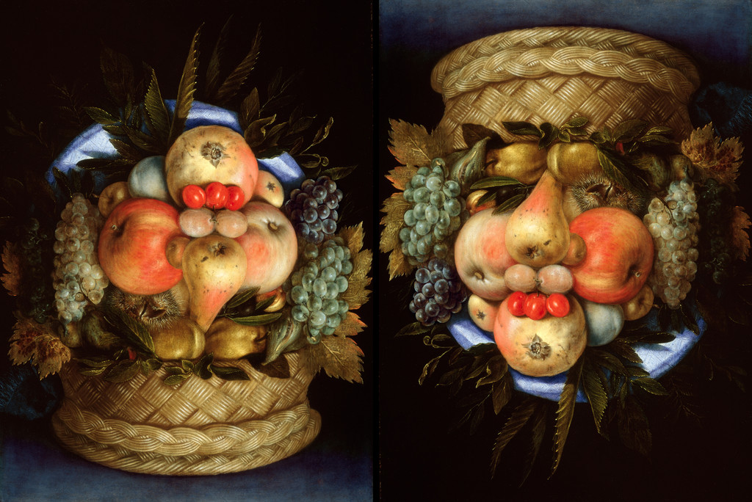

Slide 46
Not sure how to draw this…
slower
Objects
Slow
Faces
3d+motion
B&W
-
Mixed
slow
fast
VOR
Fast
Flexible
Inflexible

Slide 47
eye
vision
Seeing is dreaming
slow
Act
Highly
evolved
(hidden)
architecture
delay
Slow
vision
Illusion
Fast
VOR
Flexible
Inflexible

Slide 48
Seeing is dreaming
3D
+time
Simulation
+ complex
models
(“priors”)
Conscious
perception
Prediction
&Control
Conscious
perception
errors
Notes:
.

Slide 49
Other dimensions?
Slow
Cheap
Fast
Costly
Flexible
Inflexible
General
Special

Slide 50
Requirements on systems and architectures
accessible
accountable
accurate
adaptable
administrable
affordable
auditable
autonomy
available
credible
process capable
compatible
composable
configurable
correctness
customizable
debugable
degradable
determinable
demonstrable
dependable
deployable
discoverable
distributable
durable
effective
efficient
evolvable
extensible
fail transparent
fast
fault-tolerant
fidelity
flexible
inspectable
installable
Integrity
interchangeable
interoperable
learnable
maintainable
manageable
mobile
modifiable
modular
nomadic
operable
orthogonality
portable
precision
predictable
producible
provable
recoverable
relevant
reliable
repeatable
reproducible
resilient
responsive
reusable
robust
safety
scalable
seamless
self-sustainable
serviceable
supportable
securable
simplicity
stable
standards compliant
survivable
sustainable
tailorable
testable
timely
traceable
ubiquitous
understandable
upgradable
usable

Slide 51
Sustainable ≈ robust + efficient
accessible
accountable
accurate
adaptable
administrable
affordable
auditable
autonomy
available
compatible
composable
configurable
correctness
customizable
debugable
degradable
determinable
demonstrable
dependable
deployable
discoverable
distributable
durable
effective
evolvable
extensible
fail transparent
fast
fault-tolerant
fidelity
flexible
inspectable
installable
Integrity
interchangeable
interoperable
learnable
maintainable
manageable
mobile
modifiable
modular
nomadic
operable
orthogonality
portable
precision
predictable
producible
provable
recoverable
relevant
reliable
repeatable
reproducible
resilient
responsive
reusable
safety
scalable
seamless
self-sustainable
serviceable
supportable
securable
simple
stable
standards
survivable
tailorable
testable
timely
traceable
ubiquitous
understandable
upgradable
usable
efficient
sustainable
robust

Slide 52
PCA ≈ Principal Concept Analysis ☺
accessible
accountable
accurate
adaptable
administrable
affordable
auditable
autonomy
available
compatible
composable
configurable
correctness
customizable
debugable
degradable
determinable
demonstrable
dependable
deployable
discoverable
distributable
durable
effective
evolvable
extensible
fail transparent
fast
fault-tolerant
fidelity
flexible
inspectable
installable
Integrity
interchangeable
interoperable
learnable
maintainable
manageable
mobile
modifiable
modular
nomadic
operable
orthogonality
portable
precision
predictable
producible
provable
recoverable
relevant
reliable
repeatable
reproducible
resilient
responsive
reusable
safety
scalable
seamless
self-sustainable
serviceable
supportable
securable
simple
stable
standards
survivable
tailorable
testable
timely
traceable
ubiquitous
understandable
upgradable
usable
fragile
Simple dichotomous tradeoff pairs
efficient
sustainable
robust
efficient
wasteful
robust

Slide 53
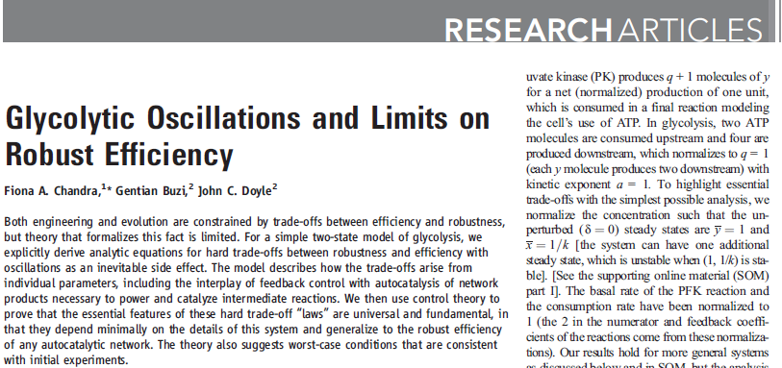

UG biochem, math, control theory
Chandra, Buzi, and Doyle
Most important paper so far.

Slide 54
Hard tradeoff in glycolysis is
robustness vs efficiency
absent without autocatalysis
too fragile with simple control
plausibly robust with complex control
fragile
10
1
too fragile
complex
No tradeoff
10
0
10
-1
10
0
10
1
expensive

Slide 55
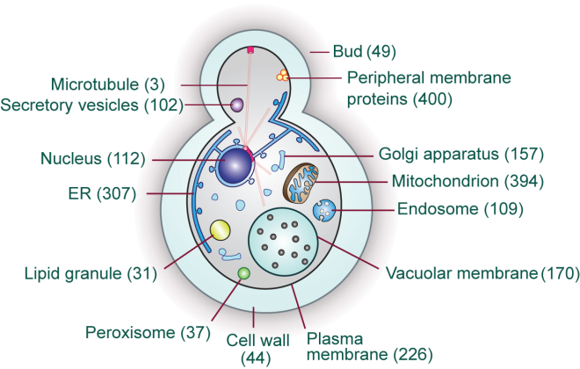
VOR
8
eye
vision
Fragility
4
slow
delay
Act
fast
Balancing an inverted pendulum
2
Control
1
Act
.05
.1
.2
.5
1
Length (meters)
10
1
fragile
too fragile
complex
No tradeoff
10
0
10
-1
10
0
10
1
expensive

Slide 56

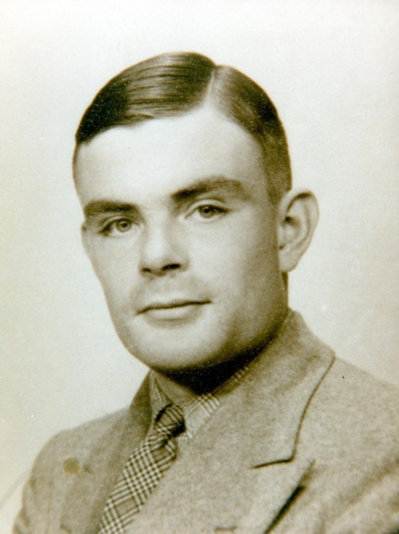
VOR
8
eye
vision
Fragility
4
slow
delay
Act
fast
Balancing an inverted pendulum
2
Control
1
Act
.05
.1
.2
.5
1
Length (meters)
10
1
fragile
too fragile
Slow
Architecture
Impossible (law)
complex
Fast
No tradeoff
10
0
Flexible
Inflexible
10
-1
10
0
10
1
General
Special
expensive

Slide 57
VOR
8
eye
vision
Fragility
4
slow
delay
Act
fast
Balancing an inverted pendulum
2
Control
1
Act
.05
.1
.2
.5
1
Length (meters)
Slow
Architecture
Impossible (law)
Fast
Flexible
Inflexible
General
Special

Slide 58
Universal laws and architectures (Turing)
Slow
Architecture (constraints that deconstrain)
Architecture
Impossible (law)
Fast
Flexible
Inflexible
General
Special

Slide 59
Computational complexity
Really slow
Slow
hard limits
Fast
Undecidable
Decidable
NP
P
Flexible/
General
Inflexible/
Specific
Notes:
.

Slide 60
Sustainable ≈ robust + efficient
accessible
accountable
accurate
adaptable
administrable
affordable
auditable
autonomy
available
compatible
composable
configurable
correctness
customizable
debugable
degradable
determinable
demonstrable
dependable
deployable
discoverable
distributable
durable
effective
evolvable
extensible
fail transparent
fast
fault-tolerant
fidelity
flexible
inspectable
installable
Integrity
interchangeable
interoperable
learnable
maintainable
manageable
mobile
modifiable
modular
nomadic
operable
orthogonality
portable
precision
predictable
producible
provable
recoverable
relevant
reliable
repeatable
reproducible
resilient
responsive
reusable
safety
scalable
seamless
self-sustainable
serviceable
supportable
securable
simple
stable
standards
survivable
tailorable
testable
timely
traceable
ubiquitous
understandable
upgradable
usable
Issues
Fast
Robust
Flexible
Efficient
Stochastics
Memory
efficient
sustainable
robust

Slide 61
Weaknesses so far
Some flaws as presented
See if we can find the flaws and fix them
What could be improved?
Model
Theory
Experiment
Suggestions?

Slide 62
Model?
1 dimension with 4 states?
What about the other 2 dimensions?
Let’s imagine (but not derive) a 10 state model and see what would happen
New issues arise

Slide 63
noise
error
eye
vision
delay
Control
Act

Slide 64
noise
error
eye
vision
delay
easy
Control
hard
Act
easy

Slide 65
noise
error
eye
vision
delay
easy
Control
hard
Act
easy

Slide 66
Model to Theory?
Linearization? Mostly ok.
Actuation and sensing, mostly ok.
Noise model? Needs work. Why?
Noise and delay is from measuring distance using stereopsis . How to model this?
What about all the detailed physiology of muscle, joints, bone, nerves, etc?
Need layered control architectures.

Slide 67
Theory
Analytic results are not scalable
Aim not analytic formulas but tractable algos

Slide 68
Main lessons
Theory: hard limits on closed loop performance, aggravated by
Instability (unstable poles)
Delay
Unstable zeros
Neuroscience specific

Slide 69
Instabilities in technology
Efficiency
Autocatalysis

Slide 70
Select instabilities in biology
Working backwards
Society/agriculture/weapons/etc
Bipedalism
Maternal care
Warm blood
Flight
Mitochondria
Translation (ribosomes)
Glycolysis (see 2011 Science paper)

